Slide 1
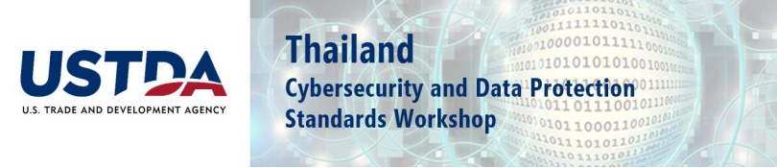
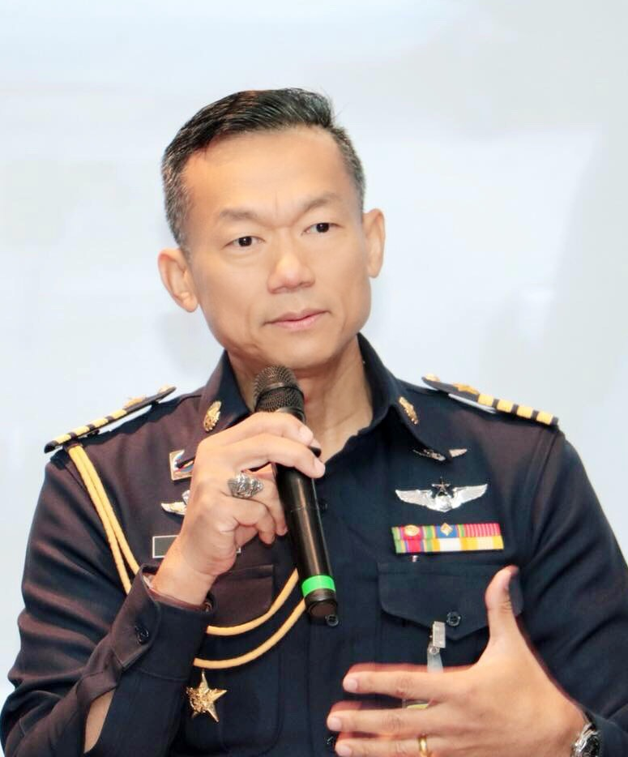





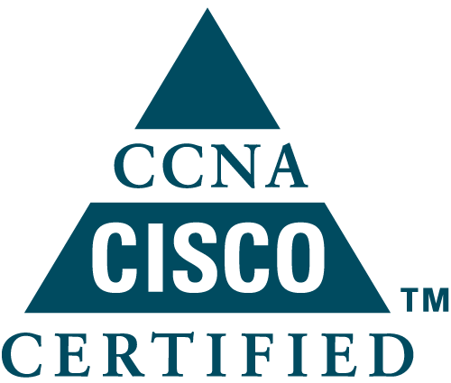
Cybersecurity Regulatory Overview and Update
Group Captain Amorn Chomchoey
Director Cyber Operations Division, Royal Thai Air Force Cyber Center
National Cyber Security Agency Working Group

Slide 2

Topics
National Cyber Strategy
Mission Function Structure for NCSA (National Cyber Security Agency)
Cybersecurity Challenges for Thailand

Slide 3
National Cyber Strategy
(Draft) Thailand National Cybersecurity Policy and Strategy Landscape
Vision
Promote Thailand's essential services, secure and cyber resilient
4 Strategies
Establish mechanism for preparedness and resilience
Promote secure and resilient critical information infrastructure services
Promote Safe and Trusted Digital Space Society
Build Cybersecurity Capacity and Capability

Slide 4
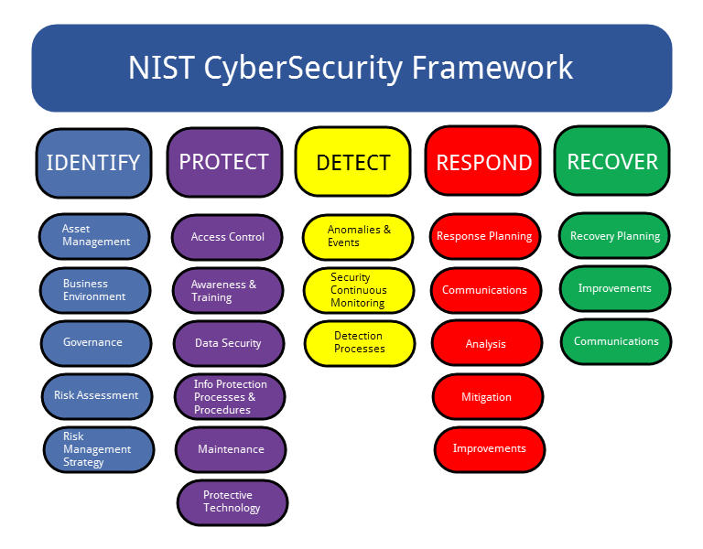
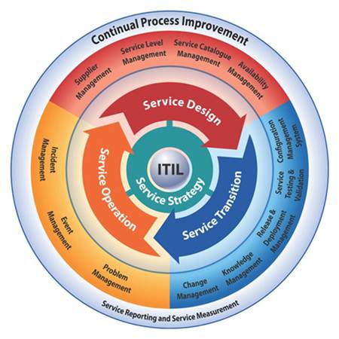
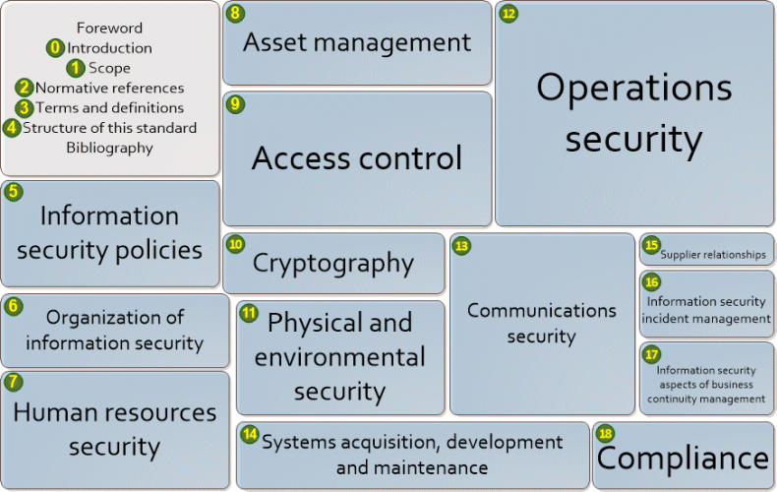
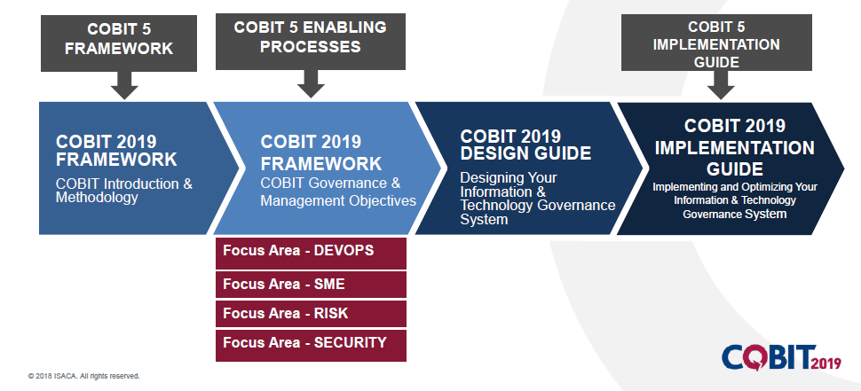
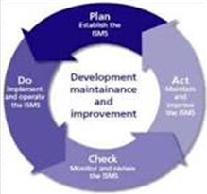
Cybersecurity Threats and How to Defend
Regulatory Landscape for Cybersecurity
ITIL (Network Operations and Services Mgmt.)
ISO 27001/27002 (IS-MS/InfoSec)
NIST RMF, 800-53 Controls Framework
COBIT (Security Operations Services Mgmt.)

Slide 5
Mission Function Structure for
NCSC is a government agency
with a direct chain of command
to the Prime Minister
2020
2021
2022
2022
Establishing NCSA
Increase Capabilities of offices and systems
Office management
Policy and Planning / Supervising and Monitoring Cyber security
1
Establishing necessary regulations
1
Encouragement of national policies and plans / Baseline
2
Funding scheme 2021-2022
Announcement of which are Critical Services
and regulating or supervising agency CII
2
3
Proposed a secondment roster to the cabinet
3
Duties and roles of NationalCERT
4
Selection of a temporary workplace
Selection of staff
4
Guidelines for development of NCSC
in preparation to deal with potential cyber security incidents
5
Implement the action plan of NCSA
5
Preparing a report on the occurrence of a cyber impact
6
Integrating cooperation between agencies

Slide 6
NCSA’s 3-year Action Plan (2021-2022)
To provide Thailand with stability and capability
to deal with cyber threats in all dimensions.
Vision
Be the leader to drive an effective management of the nation's cybersecurity,
ready to respond to all dimensions of cyber threats.
M1
M2
M3
M4
Mission
Suggesting policies, strategic plans, and improving cybersecurity laws, including studying and researching, setting guidelines, standards, and related measures in accordance with current and future situations.
Supervise, monitor, monitor, analyze, process, alert and take action to prevent, cope with and mitigate cyber threats.
Be the center for coordination, including promoting, supporting and helping government and private sectors both in the nation and overseas in order to maintain cyber security
Disseminate knowledge and understanding, and support the development of cybersecurity personnel
G1
G3
Having adequate cybersecurity personnel to meet the needs of the nation
G3
Goal
Build a cybersecurity management system that is ready to deal with all types of threats.
Government agencies and critical information infrastructure units to effectively protect and respond to cyber threats.
Build a strong cooperation network both in the nation and overseas
Relevant agencies are aware of and understand the importance of maintaining cybersecurity.
G2
G4
S1
S4
S7
Develop the capabilities to prevent, respond, monitor and resolve cyber threats.
Support the implementation of the cybersecurity strategy, policy and plan at the agency level.
Build a network of cooperation to integrate, work together, and promote and support the exchange of information on cyber threats both in the nation and overseas
Developing potential and enhancing skills in cybersecurity personnel
Raise awareness in cybersecurity
Strategy
S6
S2
Study trends, directions and prepare policies / plans / laws / regulations / announcements / measures / standards to supports the nation's cybersecurity
S9
S5
Ensuring that relevant departments can prevent, cope with and reduce the risk of cyber threats.
S8
Build competent cybersecurity personnel
S3
Promote and support research and development of technology and knowledge related to cybersecurity domain.

Slide 7

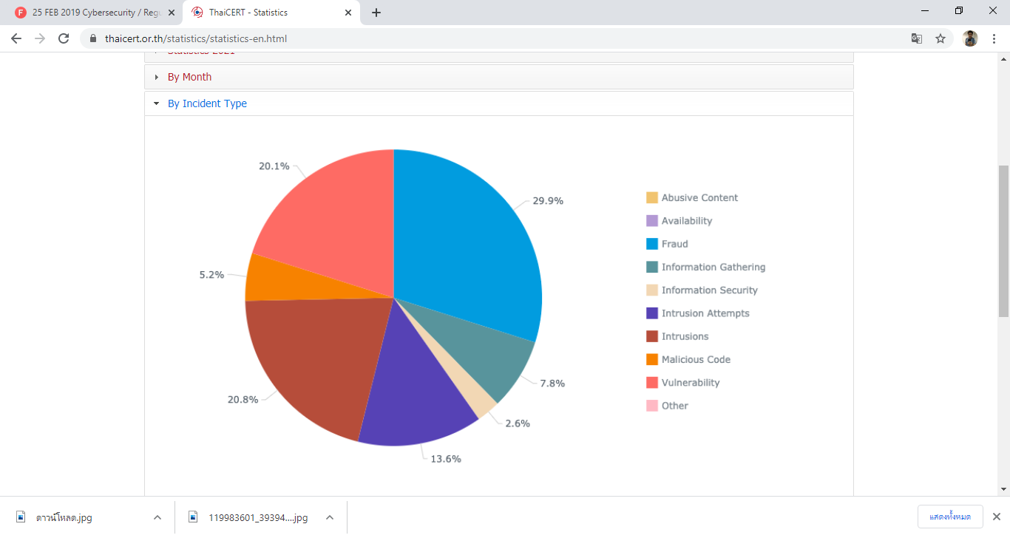
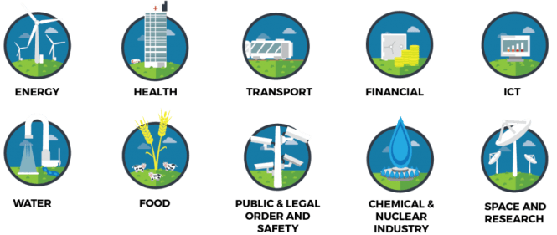

Cybersecurity Challenge for Thailand
Cyber threats are increasing across all sectors
Statistics Incident Type for 2021

Slide 8
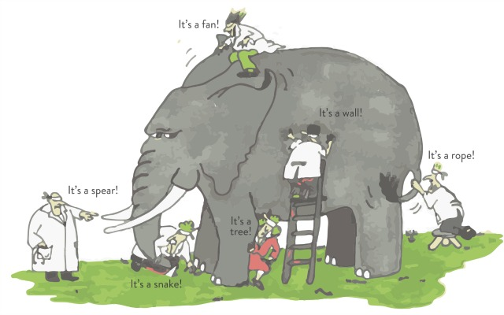


Cybersecurity Challenge for Thailand
Lack of understanding, a lot of misconceptions and interpreations.
Lack of integration between IT and Cybersecurity Team.
Lack of actual support from Top managements.
It is truly asymmetric warfare.
Cyber warfare vs Cognitive Warfare/ Information Operations vs Influential Operations
NATO

Slide 9
Thank you
contact@ncsa.or.th

